Slide 1



Understanding Parkinson’s disease using A computational model of The Basal Ganglia
V. Srinivasa Chakravarthy
Department of Biotechnology,
Bhupat and Jyoti Mehta School of Biosciences,
Indian Institute of Technology, Madras
India.

Slide 2
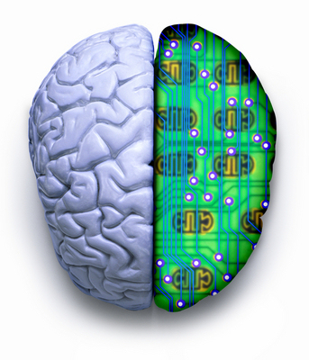
Laboratory for Computational Neuroscience, IITM
To build a
Simplified model of the Whole Brain
and
Use it to develop applications in
Medicine and Engineering.

Slide 3
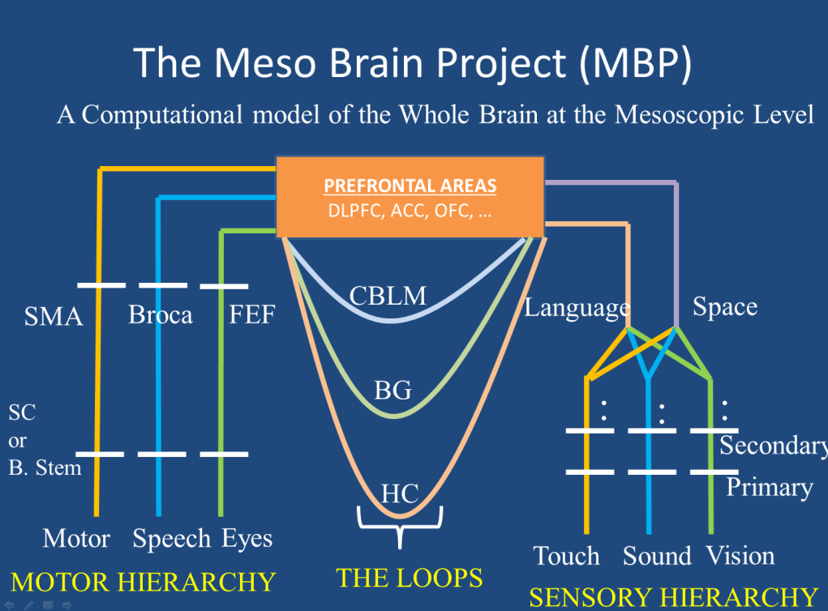

Slide 4
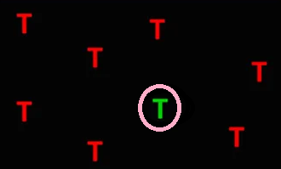
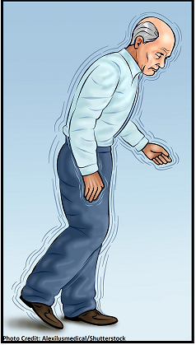
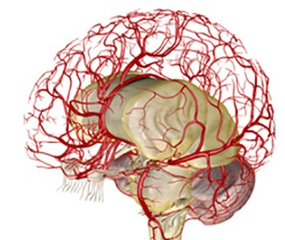
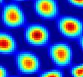
Laboratory for Computational Neuroscience, IITM
CNS
Stroke
Basal Ganglia/
Parkinsons
Spatial
Navigation
Neuro-vascular
Deep
Vision
Neural
Oscillators

Slide 5
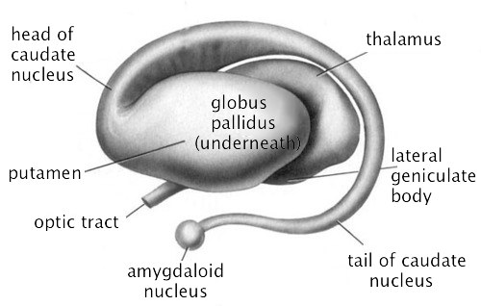
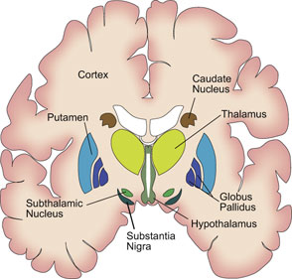
Objectives
Develop an integrated model of Basal Ganglia that can explain ALL its manifold functions,
Understand Parkinsonian motor symptoms

Slide 6
Functional anatomy of basal ganglia
Cortex
Glutamate
GABA/
Enkephalin
GPe
Striatum
Dopamine
GABA/
Substance p
GABA
Glutamate
SNc
STN
GPi
SNr
Glutamate
GPe – Globus pallidus external segment
GPi - Globus pallidus internal segment
STN – Subthalamic Nucleus
SNc – Substantia Nigra pars compancta
SNr – Substantia Nigra pars reticulata
GABA
Thalamus
Inhibitory
Excitatory
Cortex

Slide 7
BASAL GANGLIA FUNCTIONS
Action Selection
Sequence Generation
Motor Preparation
Action Gating
Goal-directed behavior
9
Reward Based Learning
Timing
Working Memory
Exploratory Behavior
(Chakravarthy et al 2010)
“The mysterious motor functions of Basal Ganglia…” – Marsden (1982)

Slide 8
COMPUTATIONAL MODELS OF BASAL GANGLIA FUNCTION
Reward Based Learning
(Montague et al, 1997; Schultz, 1998)
Sequence Generation
Action Gating
(Berns & Sejnowski, 1998)
Contreras-Vidal & Stelmach, 1995
Working Memory
BASAL GANGLIA
Timing
(Moustafa and Maida 2007)
Buhusi & Meck, 2005
Dim. reduction
(Bar-gad et al 2000)
Action Selection
Gurney et al 2001; Berns & Sejnowski, 1995; Frank 2005.

Slide 9
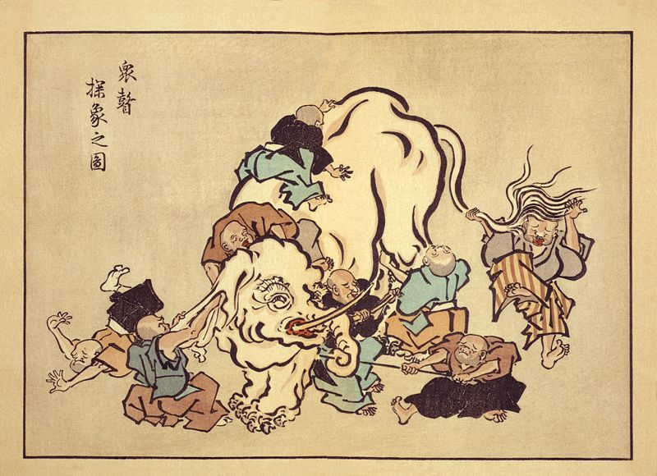

Slide 10
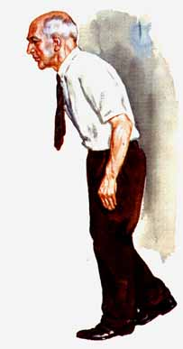

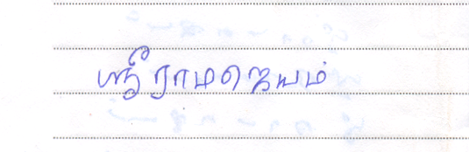
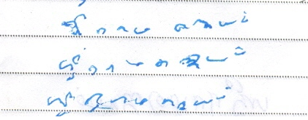
Parkinson’s disease (PD)
Progressive neurodegenerative disorder
Pathology: loss of dopaminergic neurons Substantia nigra pars compacta (SNc)
Cardinal Symptoms:
Tremor,
Rigidity,
Postural abnormalities,
Bradykinesia.
Motor symptoms in many modalities:
Reaching movements
Handwriting
Eye movements
Speech
Posture…
Normal Handwriting
PD handwriting

Slide 11
The Classical View of BG Function

Slide 12
The Direct & Indirect Pathways
(Albin et al 1989)
-
GPi
+
Stn
Indirect
Pathway
(“NoGo”)
Low DA
Direct
Pathway
(“Go”)
High DA
-
-
GPe
-
Str
SNc
DA
“NOGO”
δ₀
“GO”

Slide 13
Dopamine (DA) for fun
Brain’s “pleasure chemical”
DA release is triggered by brain stimulation, psychomotor stimulants, opiates, and food (Wise & Rompre 1989)
DA antagonists attenuate the pleasurable experience of the above (Wise & Rompre 1989)
Beautiful faces (Aharon et al 2001), images of lovers (Aron et al 2005), monetary rewards (Thut et al 1997) trigger the dopamine reward system

Slide 14
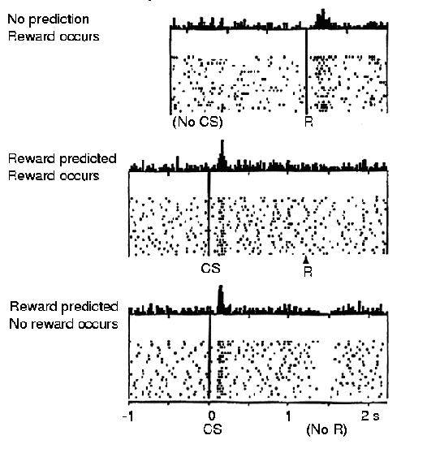
DOPAMINE AS A REWARD-RELATED SIGNAL
Schultz et al, 1997
DA = total actual future reward – total expected future reward

Slide 15
Rewards and Learning by Reinforcement
Reward (+ve reinforcement)
Stimulus
Response
Learn It
Punishment (-ve reinforcement)
Stimulus
Response
Don’t Learn It

Slide 16
Basal Ganglia and Reward Based Learning
Motor
Response
Sensory
Stimulus
Motor Cortex ← Sensory Cortex
BG
Dopamine (“Reward”)
Sensory-
motor State
SNc
BG interprets the reward and
Recommends the right action to the Motor Cortex

Slide 17





BG and Action selection
reward
punishment
Experience
(rewards/punishments)
Shapes the
Probability of choosing
An Action
+
-

Slide 18

BG and Action selection
Initial stage
Choose
Yellow
- “Value”: Reward-giving
potential of an Action
Both values are equal
Initially.

Slide 19
BG and Action selection
Reward
Choose
Yellow
Yellow fetched Reward
+

Slide 20
BG and Action selection
Reward
Choose
Y
+
“Value” of Yellow is
Increased

Slide 21
BG and Action selection
Initial stage
Choose
Y
“Value”: Reward-giving
potential of an Action

Slide 22
BG and Action selection
Choose
Red
“Value”: Reward-giving
potential of an Action

Slide 23
BG and Action selection
Punishment
Red resulted in
Punishment
-

Slide 24
BG and Action selection
Punishment
Reward → GO
Punishment → NoGo
-
“Value” of Red is
reduced.

Slide 25

The need for exploration
reward
punishment
reward/or
punishment?
GO
NOGO
EXPLORE
+
-
Shall I check this one out?

Slide 26
Components of reinforcement learning
Reward signal
“Values”
Exploration
Actions
State

Slide 27

RL components in basal ganglia
Actions (Yellow or Red?)
Direct
Pathway
(“Go”)
GPi
Stn
Indirect
Pathway
(“NoGo”)
GPe
Striatum
Dopamine
(Reward/punishment)
“Values” are stored here!
SNc
(State)

Slide 28
The Classical View of BG: The GO/NOGO model
Indirect
Pathway
(“NoGo”)
Low DA
Direct
Pathway
(“Go”)
High DA
Go
NoGo
SNc
(Albin et al 1989)
Dopamine

Slide 29
The Direct & Indirect Pathways
-
GPi
+
Stn
Indirect
Pathway
Direct
Pathway
-
+
-
GPe
-
Str
SNc
DA
STN-GPe LOOP:
Exhibits complex dynamics
(Terman et al 2002)

Slide 30
An alternative View of BG: The GO/EXPLORE/NOGO model
Exp lore
Indirect
Pathway
Direct
Pathway
No
Go
Go
SNc
Dopamine
NOGO
EXPLORE
GO
(Chakravarthy et al 2010)
DA

Slide 31
STN-GPe system – in experiments
Decorticated Kittens show exploration (Grillner et al 1997)
STN lesions cause perseverative behavior (Baunez et al, 2001)
Reduced complexity under dopamine-deficient conditions, (increased correlation, but no rate change) in activities of neurons of STN and GPe (Bergman et al, 1994; Nini et al 1995, Raz et al 2000; Brown et al 2001)

Slide 32
The STN-GPe system – in modeling
Excitatory-inhibitory loop → can produce oscillations (Gillies et al 2001, Bevan et al 2003)
Realistic models exhibit complex dynamics (Terman et al, 2002):
1) complex spiking 2) traveling waves,
3) synchronized bursts etc

Slide 33
A simple model of basal ganglia
(Chakravarthy & Priyadarshini,
Encyc. of Computational Neuroscience, 2014)

Slide 34
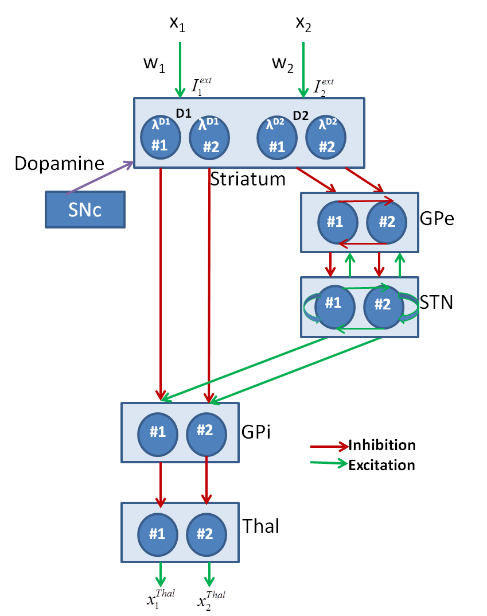
A Schematic of the Model

Slide 35
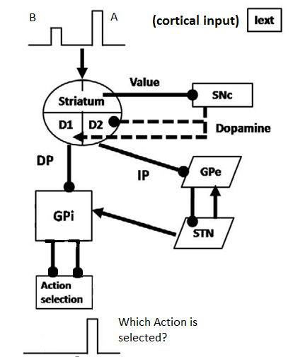
Classifying Action Selection Regimes
Cortical input presents
Two Competing Actions:
A and B (A > B)
Action Selection at Thalamus:
Selection Regime DA
A GO HI
NONE NOGO LO
B is selected EXPL MID

Slide 36
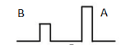
Striatum Model
GPi
GPe
D1 D2
MSNs
D1 MSNs
D2 MSNs
DA(δ)
Cortico
Striatal
connections
DA
DA
I_{ext}
I_{ext}
I_{ext}
D1 and D2 are the Hopfield 1D neuron layers

Slide 37
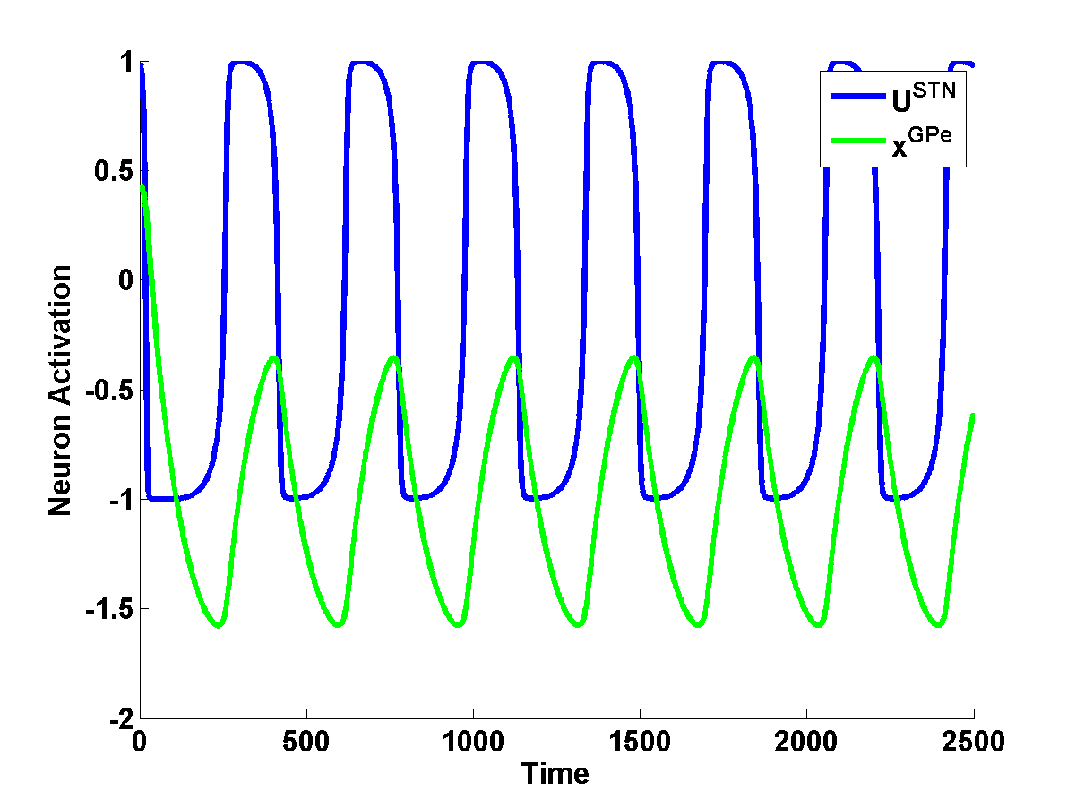
STN-GPe Model
σ
I_{HDP}
STN
w
-
+
w
GPe
σ
I_{D2_STR}
Modeled as excitatory-inhibitory pair of 1D-neural layers
One to one connections between STN and GPe
Lateral connections (fully connected) within STN and Gpe
Strong w and weak σ produces chaos (Kalva et al 2012)
Increased I_{D2_STR}, increased I_{HDP}, or decreased DA → STN-Gpe induces oscillations (Magill et al 2011; Kumar et al 2011)

Slide 38
Summation at GPi
GPi combines the GABAergic striatal outflow via DP with glutamatergic STN output from IP.
The combination of DP and IP outflows in GPi is modulated by dopamine projections.
Thalamus
U_{GPi}
λ^{D1} (δ_{V})
λ^{D2} (δ_{V})
#1
#2
δ_{V}
GPi
SNc
(Kliem, Maidment et al. 2007)
STN
Striatum
(Value)
Inhibition
Excitation
Notes:
Kliem et al (2010) show that when D1 receptors in GPi, which are primarily located on the axons of GABAergic striato-pallidal projections, are activated, firing levels of GPi neurons are reduced (Kliem, Maidment et al. 2007).

Slide 39
If
Action Selection in Thalamus
Motor cortex
#1
#2
Thalamus
If (x_{i}(t) > x_{th}) for some i, at some time t,
- Select ‘i'th action
- Reset all other thalamic neurons.
I_{GPi}
39

Slide 40
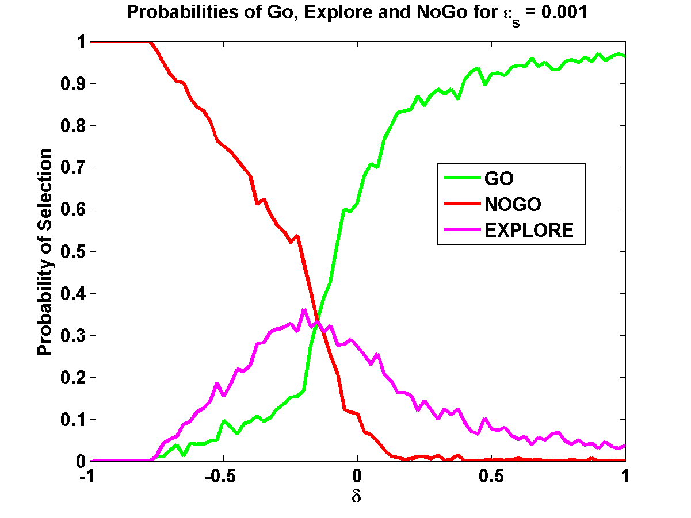
Binary Action Selection
40

Slide 41
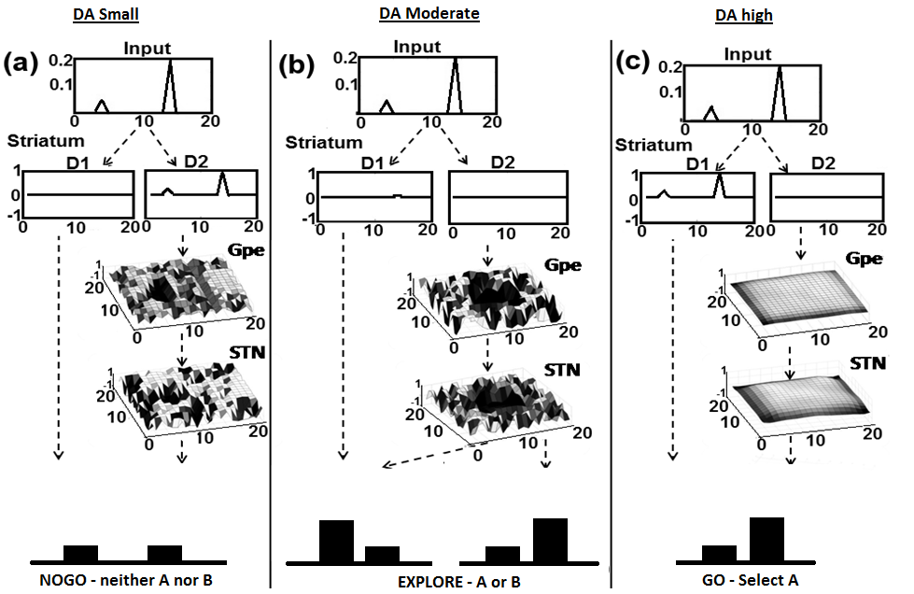
Effect of DA level on Action Selection
DA low
DA med
DA high

Slide 42
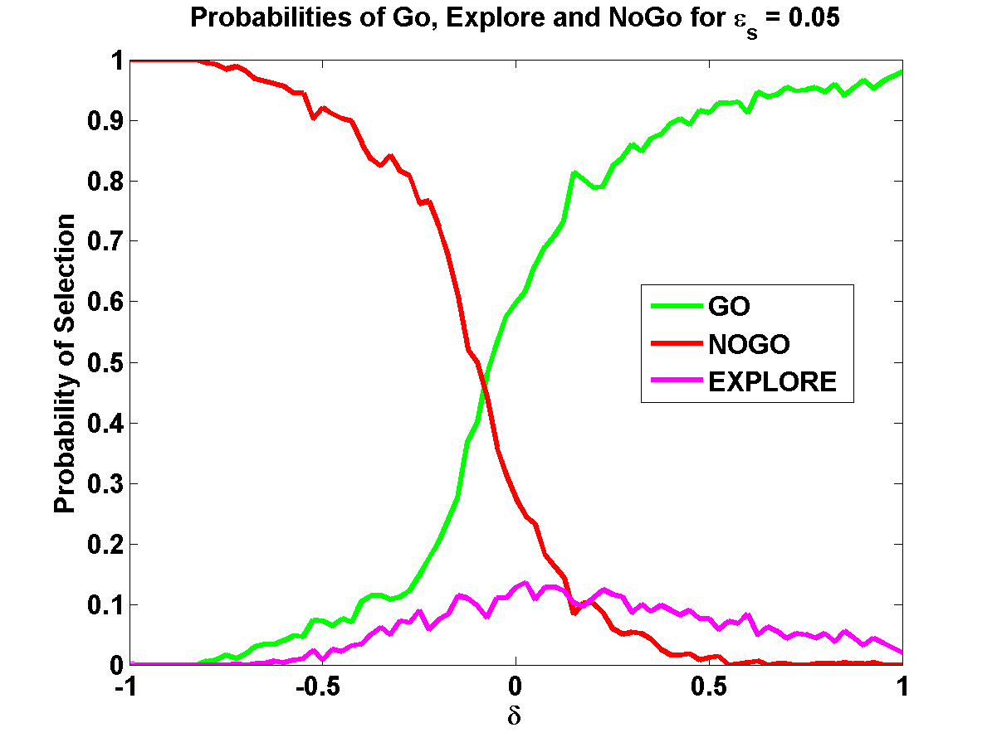
Effect of STN-GPe dynamics on Action selection
ε_{s} = strength of lateral conns in STN
Stronger STN laterals
→ more synchrony in STN-GPe oscillations
ε_{s} = 0.001
ε_{s} = 0.95

Slide 43
The Three Regimes of BG dynamics

Slide 44
N-Armed Bandit Problem
Next Action.
X(t+1)
Thal
GPi
Sum of outputs
of D1 MSNs =V
STN
GPe
V
Str
r
SNc
δ = TD error = r(t) + γ V(t+1) – V(t)
For learning Value
δ_{V} = Value gradient = V(t+1) – V(t)
For switching between DP and IP
For Exploration
δ_{V}, δ
Previous
Action (X(t))

Slide 45
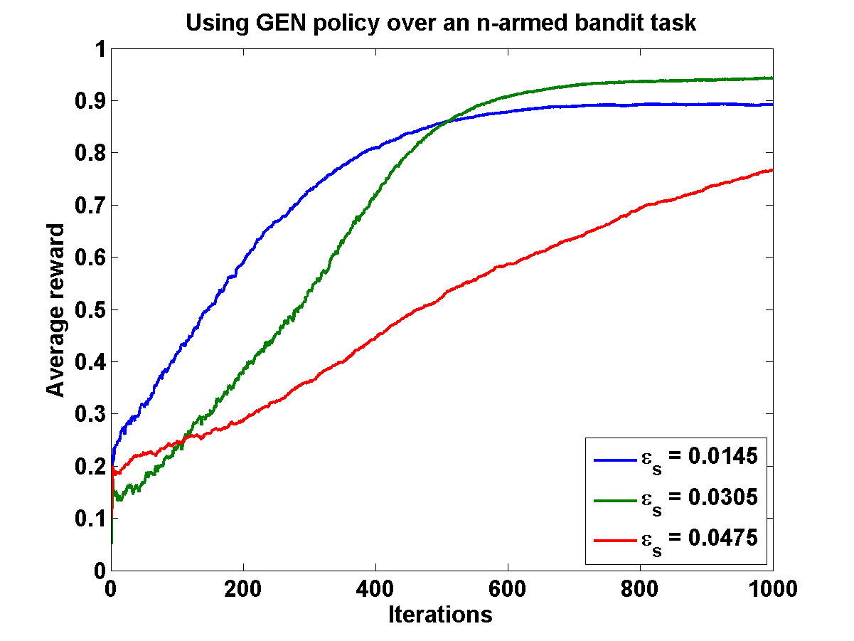
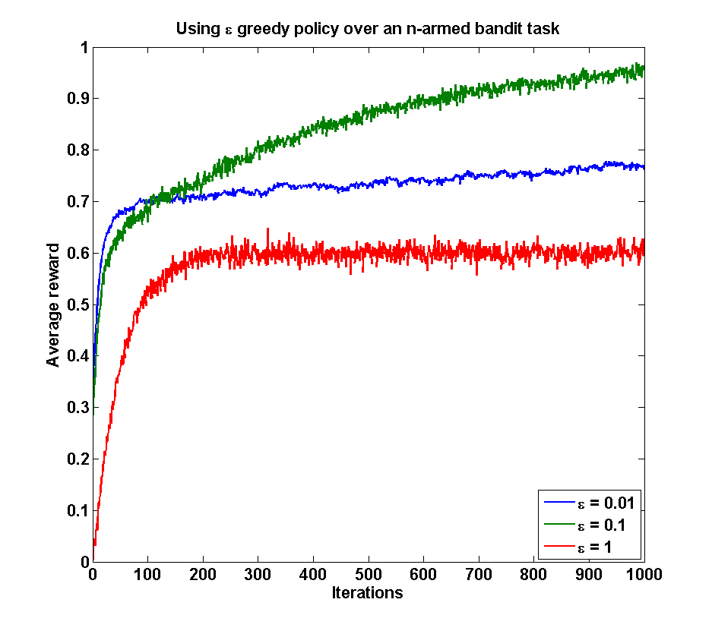
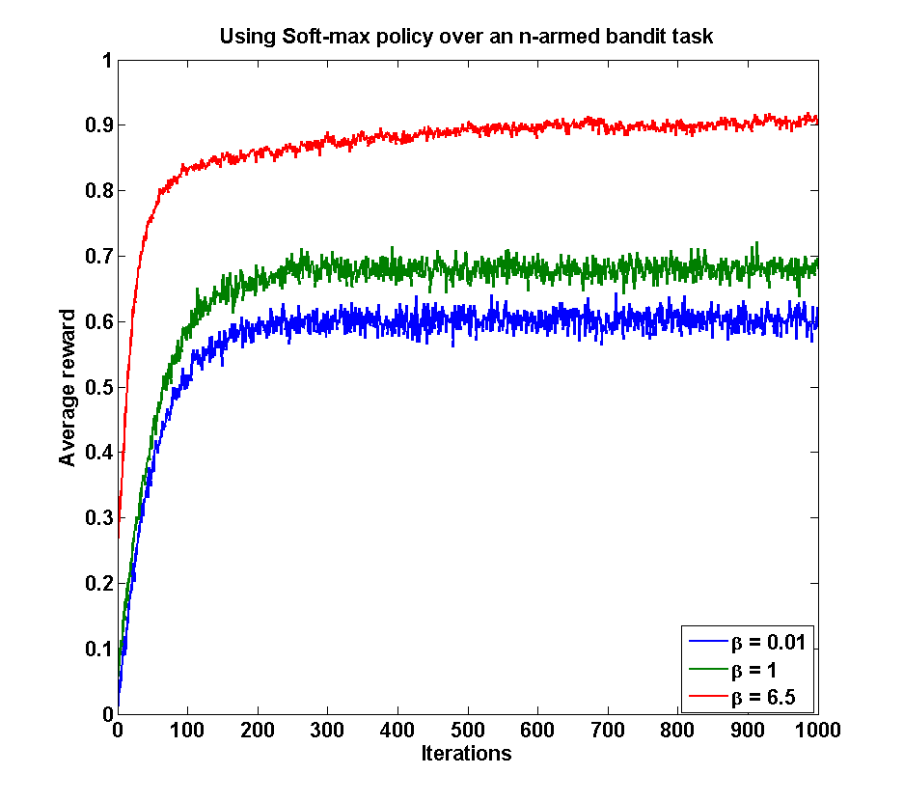
N-Armed Bandit Problem
A
B
C
A – proposed BG model (ε_{s})
B – ε-greedy policy (ε)
C – Soft-max policy (β)

Slide 46
The GO/EXPLORE/NOGO (GEN) Policy
(Three conditions)
Next Action
X(t+1)
BG
δ_{V}
SNc
Previous Action
X(t)
GEN represents a form of
Stochastic Hill-climbing
Over the VALUE landscape!!!
46

Slide 47
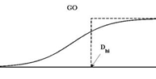
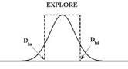
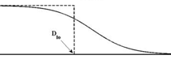
The GO/EXPLORE/NOGO (GEN) Policy
(The Three Conditions are Combined)
47

Slide 48
GEN Policy and Stochastic Hill-climbing over Value function
δ_{V} = Value gradient = V(t+1) – V(t)
2
1
V
3
1. δ_{V} > δ_{uc}: ΔX(t+1) = ΔX(t); “GO”
2. δ_{lc} < δ_{V} < δ_{uc}: ΔX(t+1) = φ; “Explore”
3. δ_{V} < δ_{lc}: ΔX(t+1) = 0; “NOGO”

Slide 49
Conclusions
BG model for action selection
DP → exploitation and IP → exploration
STN-GPe as a subcortical substrate for exploration
Chaotic activity in IP drives exploration
Value is computed in the striatum
TWO DOPAMINE signals:
Corticostriatal plasticity controlled by DA (δ)
Switching between DP and IP, and exploration is driven by δ_{V}.
GEN Policy results in stochastic hill-climbing over Value profile

Slide 50

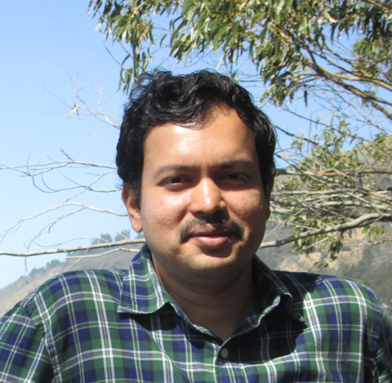



A comprehensive model of the Basal Ganglia
Basal ganglia
Handwriting
Spatial
Navigation
Normal | PD
Reaching
Saccade
Generation
Gait
Risk
Precision
Grip
DBS
Birdsong
Moustafa et al 2016
Balasubramani et al 2015a
Helie et al, Front. CN, 2014
Balasubramani et al, Front. CN, 2014
Gupta et al, Front. CN, 2014
Sukumar et al, PLoS One 2012
Kalva et al, Neural Netw 2012
Magdoom et al, Neural Comp, 2011
Krishnan et al, Neural Netw., 2011
Chakravarthy et al, Biol Cyb, 2010
Mandali et al, 2015
Balasubramani et al 2015b
Chakravarthy & Balasubramani, 2014
Muralidharan et al, Front CN, 2014
Chakravarthy, PLoS One, 2013
Maya et al, IJBMC, 2012
Joseph et al, Neurocomp, 2010
Gangadhar et al, Hum Mov Sci, 2009
Gangadhar et al, Neural Comp., 2008
Deverajan et al, IJNS, 2006

Slide 51
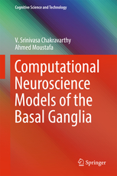

Slide 52
Models of motor functions of BG
A model of BG in:
Reaching (Muralidharan et al, OCNS, 2016)
Gait control (Muralidharan et al, Frontiers in Comp Neusc, 2013)
Willed Action (Chakravarthy, PLoS One, 2013)
52

Slide 53
A LARGE SCALE CORTICO-BASAL GANGLIA MODEL TO UNDERSTAND THE NEURAL DYNAMICS OF TARGETTED REACHING
Vigensh Muralidharan, Alekhya Mandali, Pragathi Priyadharsini, Hima Mehta, Sabysachi Shivkumar and V. Srinivasa Chakravarthy

Slide 54


Understanding Reaching
“ Understanding reaching and pointing movements depends on the knowledge of physics, biology, mathematics, robotics and computer science.”
Reza Shadmehr and Steven Wise
Several approaches to studying reaching.
Cortico-basal ganglia model of reaching to understand the contributions of this loop to ellicit optimal reaching behavior.

Slide 55
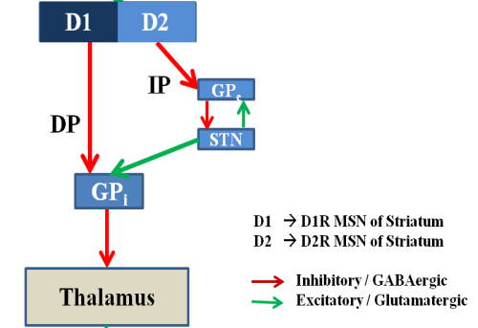
CORTICO-BASAL GANGLIA MODEL OF REACHING
p(t)
g(t)
s(t)
Prefrontal Cortex
Motor Cortex
Proprioceptive
Cortex
Δg(t-1)
Δg(t)
mn(t)
Motor Neurons
Basal Ganglia
2-link Arm model
ml(t)
Figure 1: Block diagram of the lumped reaching model

Slide 56
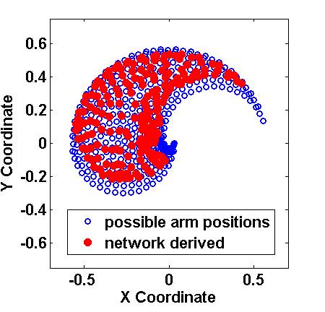
Reachable positions of the arm before and after training
Motor Cortex
Proprioceptive
Cortex
Motor Neurons
2-link Arm model
Blue dots: Workspace - All possible positions reachable by the arms
Red dots: the network derived arm positions

Slide 57
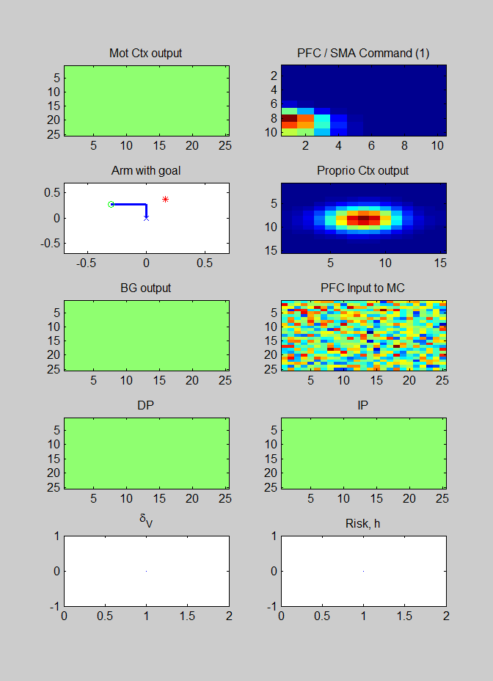
Simulations – Reaching multiple targets

Slide 58
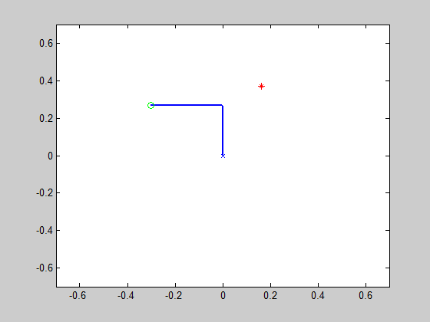
Simulations: PD Condition
Arm with Bradykinesia and Rigidity
Arm with tremor

Slide 59
Kinematics of reaching to a target: Controls and PD
Expt: Majsak MJ, Kaminski T, Gentile AM, Flanagan JR: The reaching movements of patients with Parkinson's disease under self-determined maximal speed and visually cued conditions. Brain 1998, 121(4):755-766.

Slide 60
Movement trajectories during a reach: Controls and PD
Controls
PD

Slide 61
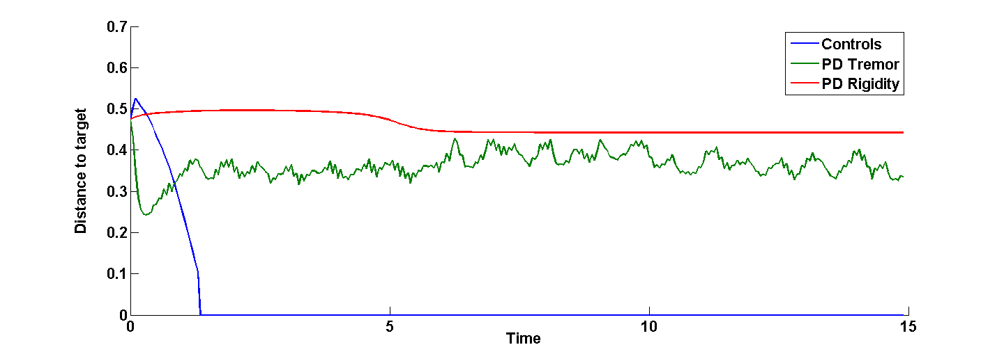
Pathology of the arm

Slide 62
Understanding freezing of gait in Parkinson’s disease : A computational study
(Muralidharan, Balasubramani et al, Front Comp Neuro, 2013

Slide 63
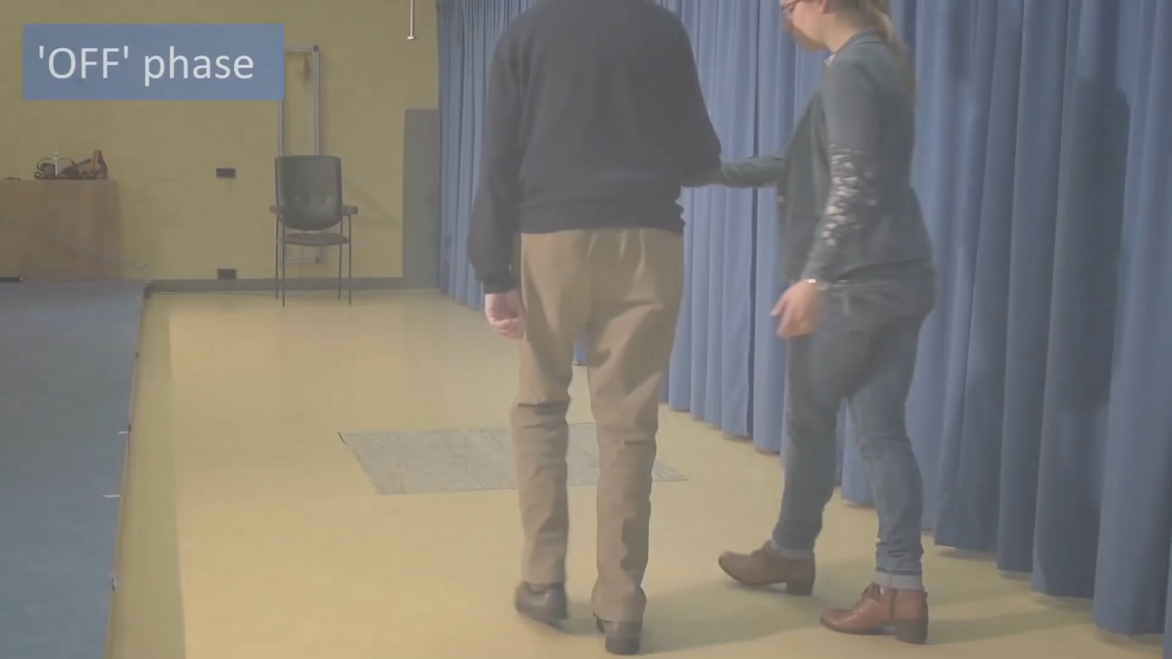
Freezing of Gait
https://www.youtube.com/watch?v=3-wrNhyVTNE

Slide 64
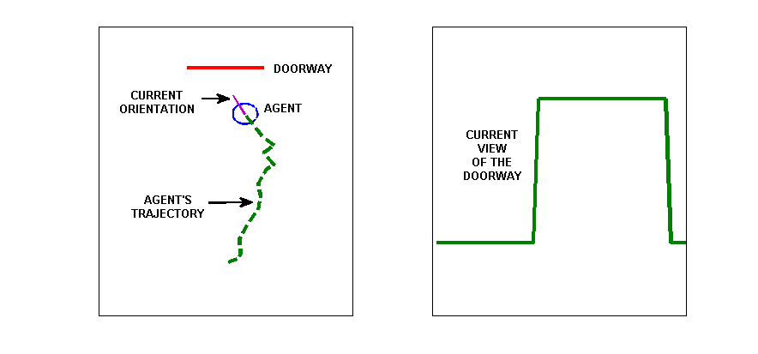
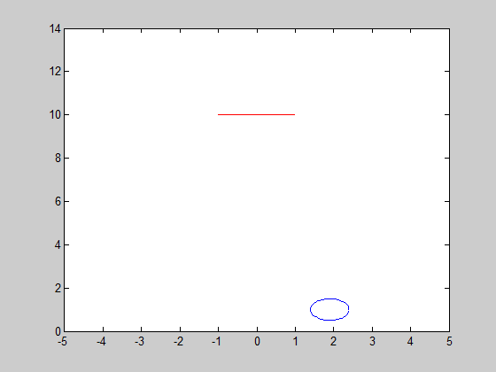
The Problem Setup
(Cowie et al, 2010)

Slide 65
Model developed to understand FOG
Muralidharan et. al., 2014

Slide 66
Velocity profiles of Controls and PD
Fig (a) is the Cowie et al. 2010 study and velocity profiles w.r.t a no door condition.
Model Fig (b) replicates the results seen in Cowie et al., here the velocity profiles are normalised by averaged velocity far before the doorway (5-6 m)
Muralidharan et. al., 2014

Slide 67
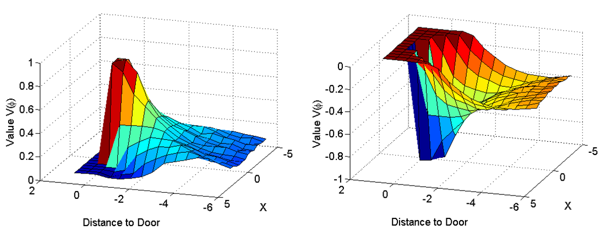
Value function over space
Controls
PD
Value dips down near the doorway in PD indicating low expectancy to reward in the vicinity of the door

Slide 68
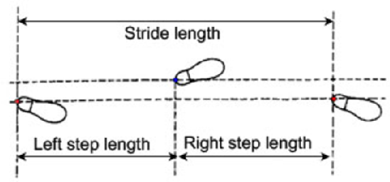

Slide 69
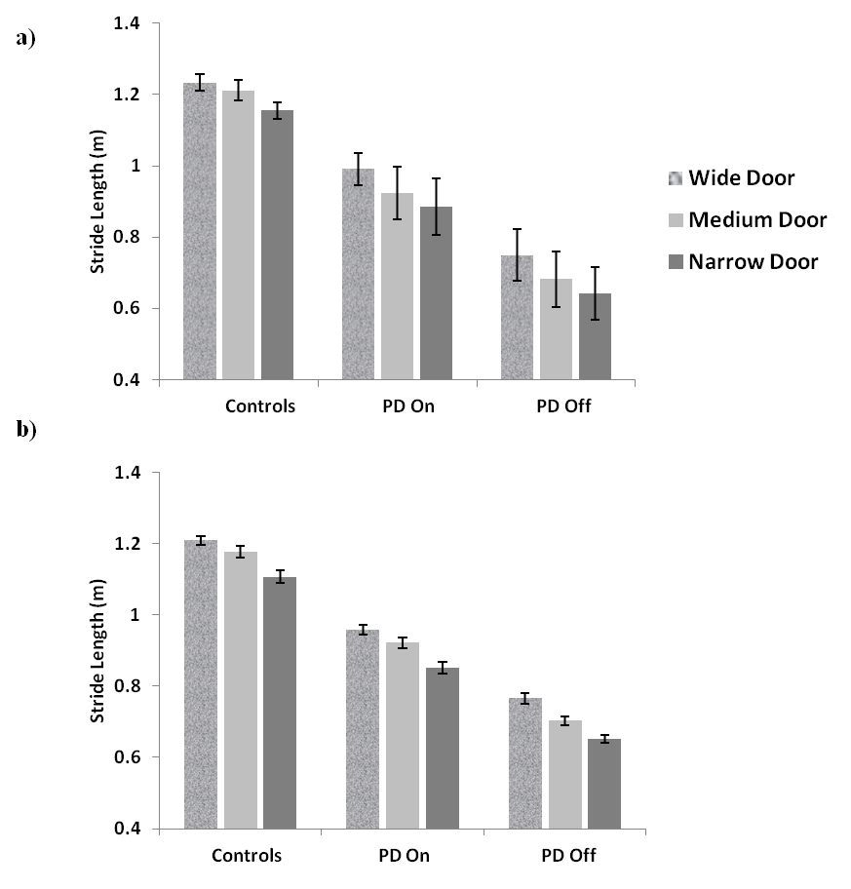
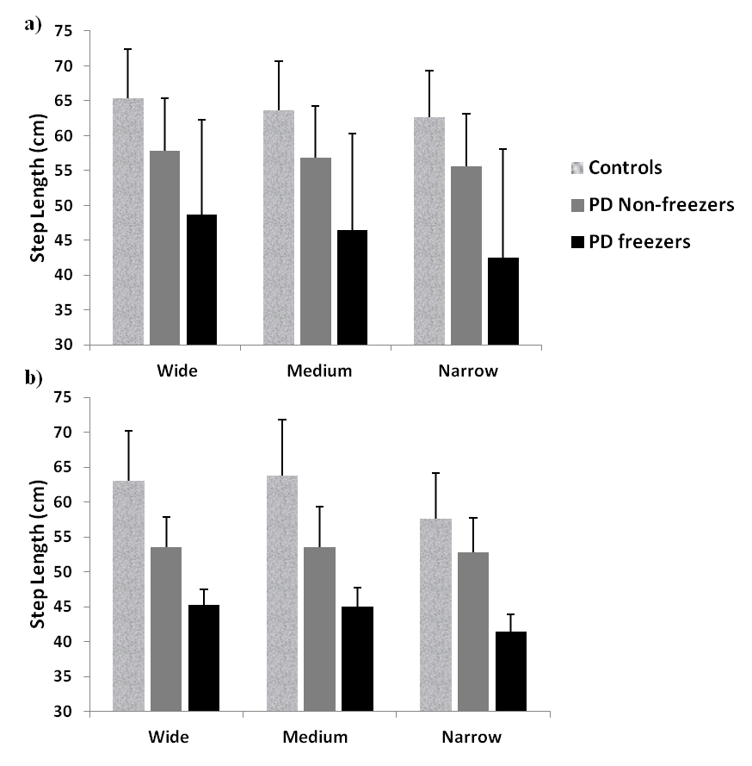
Stride and Step Length Profiles for Controls and PD
a – Experimental Results (for Cowie et al. and Almeida and Lebold); b – Corresponding Model results

Slide 70
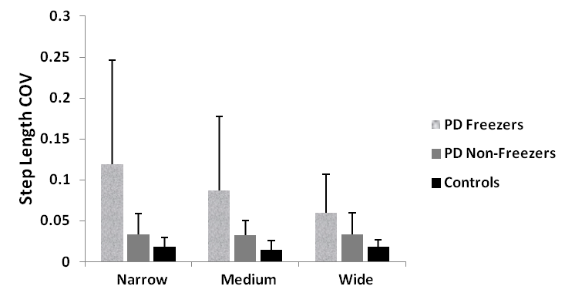
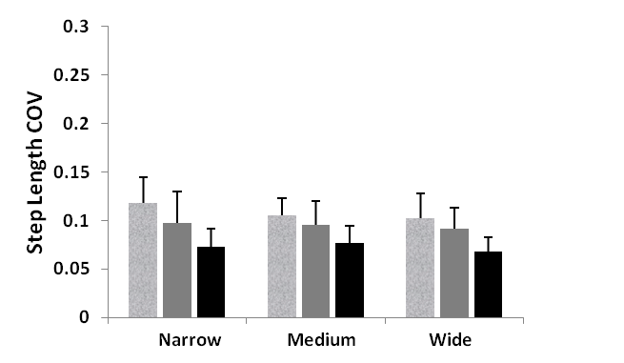
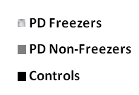
Increased variability seen in PD Freezers
PD freezers also show increased step length variability compared to non-freezers and controls.
The model also captures this trend effectively.

Slide 71
Conclusion: On Evaluating Space
PD gait is not a motor problem;
it is a space evaluation problem
Safe
(High Value)
Obstacle
Unsafe
(Low Value)
The Concept of Space Evaluation can have potential applications in
ARCHITECTURE.

Slide 72
Alekhya Mandali
Modelling the Role of STN-DBS in Decision Making

Slide 73
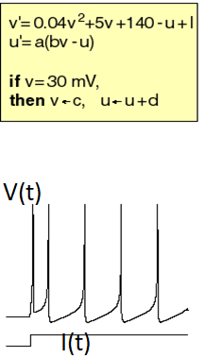
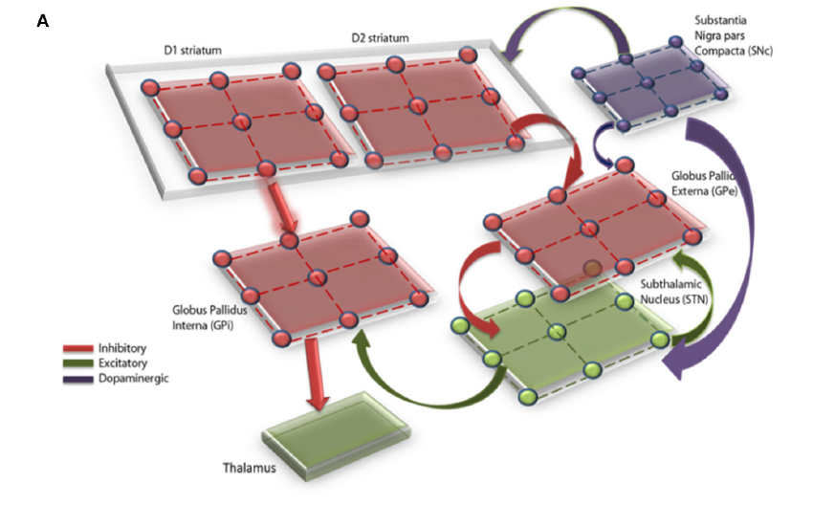
Modeling the Role of STN-DBS in Decision Making
Spiking neural network model of
The Basal Ganglia
Izhikevich
Spiking neuron
model
(Mandali et al 2015)

Slide 74
Stochastic n-arm bandit task
Each card gives
some reward points
Choose cards so as as
to maximize rewards
1
2
3
4
(Baunez et al
2001)
A sample payoff pattern of 4 arms across 300 trials
Mandali, et al, Frontiers in Neuroscience, 2015.

Slide 75
Stochastic n-arm bandit task
%Exploitation
Model
Vs
Experiment
%Exploitation
model
Mandali, et al, Frontiers in Neuroscience, 2015.

Slide 76
STN
Healthy
STN
PD
Power
Spectrum
STN after
DBS
Effect of
Current
On
Synch
DBS
Current

Slide 77
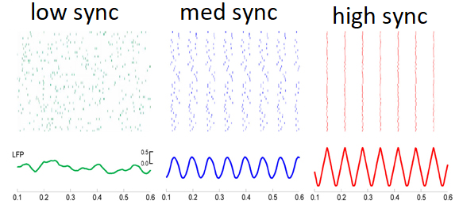
STN in PD
normal
PD
Normal STN: neural oscillations are DESYNCHRONIZED
PD STN: neural oscillations are SYNCHRONIZED
(beta band = 13-35 Hz)

Slide 78

Cognitive Function of PD in medication and DBS
Iowa Gambling Task
Deck A
Deck B
Deck C
Deck D
 | Deck A | Deck B | Deck C | Deck D
Gain per card($) | 100 | 100 | 50 | 50
Loss per card($) | 1250 | 1250 | 250 | 250
Probability of Loss | 0.5 | 0.1 | 0.5 | 0.1
Net per 10 cards ($) | -250 | -250 | 250 | 250
IGT Score= #(C+D)-#(A+B)

Slide 79
Healthy vs PD ON condition
Healthy controls
Medically (L-dopa) Treated PD patients
(Gescheidt et al 2012)

Slide 80
Medication + DBS
PD ON
DBS ON and baseline
(Oyama et al 2011)

Slide 81
Summary and Conclusions
A spiking neuron network of the Basal Ganglia
Simulates Decision Making under conditions of:
Normal
PD
Medication
DBS
Possible to generalize to other Decision Making functions.

Slide 82
A model of Role of Basal Ganglia in Willed Action (Chakravarthy, PLoS One, 2013)

Slide 83
Willed Action
A “pure” form of voluntary action
Two types of vol. action: “ideo-motor” actions and “willed actions.” (James, 1890)
Readiness Potential (BP):
A slow buildup of activity over midline (Cz) over a second before voluntary action (Deecke and Kornhuber 2003)
Difficulty in initiating movement in Parkinson’s disease – a disorder of “Willed Action”

Slide 84
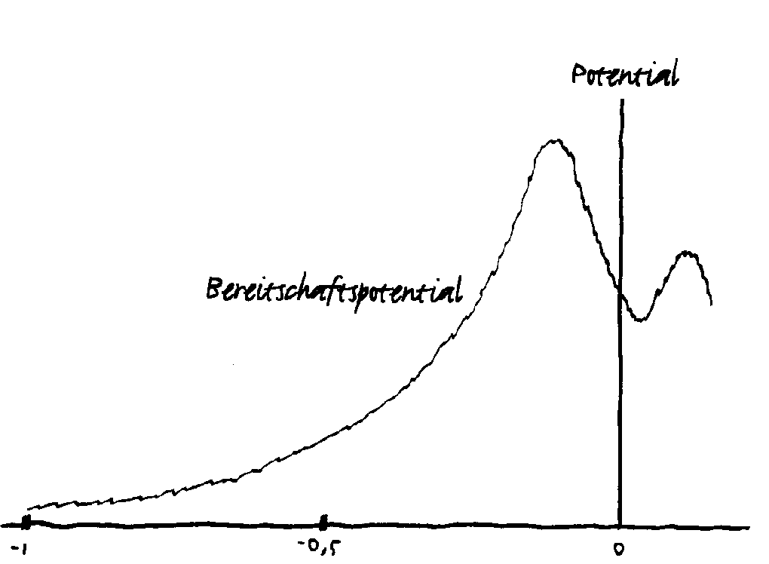
Hypothesis
“Willed action” signal is a weak signal
It needs a mechanism for amplification
Basal Ganglia amplifies willed action signal by Stochastic Resonance

Slide 85
Stochastic Resonance
A gradient system with noise added, driven by a weak (periodic) signal
Best amplification is obtained at an optimal noise
Observed in sensory systems

Slide 86
Basal Ganglia and SR
SR component | Neurobiological component
Potential function | Value function computed in striatum
Gradient Descent | Go + NoGo regimes
Noise | Chaotic activity of STN-GPe
Forcing signal | Will command from pre-SMA/SMA
(Chakravarthy, PLoS One, 2013)

Slide 87
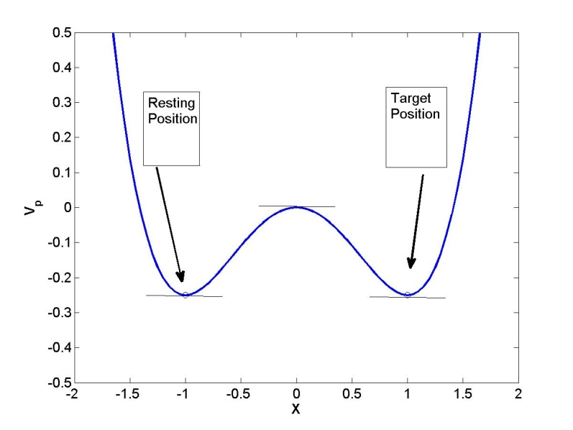
Willed Action and Reaching
Two possible states of the hand
A weak “kick” is given
Probability of Reach calculated under various conditions

Slide 88
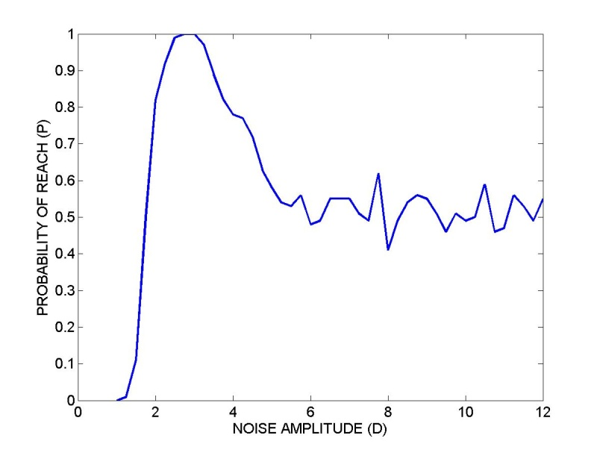
Effect of IP Noise on Reaching Probability

Slide 89
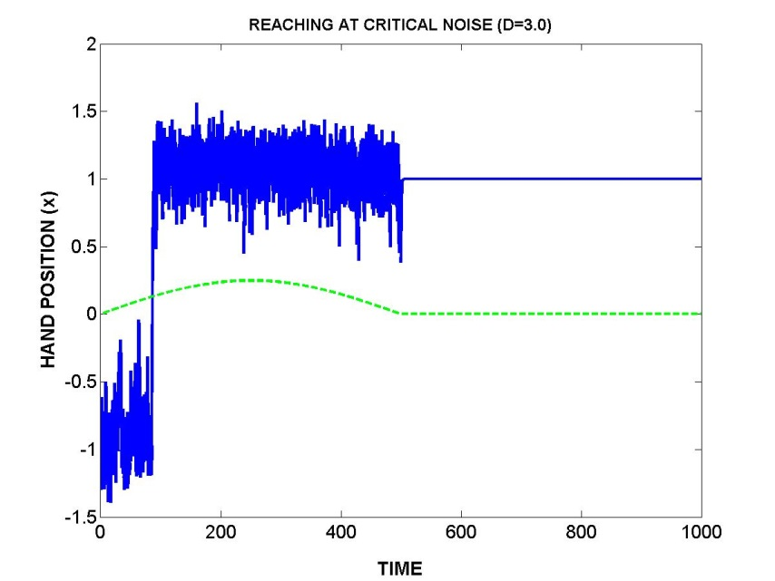


Normal and PD Reaching
Normal
Akinetic
rigidity
Tremor

Slide 90


Slide 91
Conclusions
RL components of BG reinterpreted in terms of SR
DP → gradient dynamics; IP → noise
Optimal noise in IP → normal
Subthreshold noise → akinetic rigidity
Superthreshold noise → tremor
Perhaps the first model that uses SR in motor function

Slide 92

Overall Summary
Analogies to Evolution =
randomness (exploration) +
screening (exploitation)
GO/EXPLORE/NOGO picture
A variety of functions can be explained
Navigation, reaching, gait, saccade generation, precision grip, bird song…

Slide 93
The Theory works at multiple levels
Go/Explore/NoGo Policy
Go/Explore/NoGo
Regimes observed
Rate-coded dynamic
Neural network model

Slide 94
The Theory works at multiple levels
Go/Explore/NoGo Policy
Chakravarthy &
Balasubramani, 2014)
(Kalva et al 2012;
Go/Explore/NoGo
Regimes observed
Rate-coded dynamic
Neural network model
Chakravarthy &
Balasubramani, 2014)
Go/Explore/NoGo
Regimes observed
here too!
Spiking neuron
(Izhikevich) network of BG
(Mandali et al, 2015)
(Mandali & Chakravarthy,
2016)

Slide 95
Other Neuromodulators
Modeling Serotonin in BG – links to risk evaluation (Balasubramani et al 2014; Balasubramani et al 2015a,b)
Reconciles three existing computational theories of Serotonin function:
Risk-sensitivity (Long et al 2009)
Time-scale of reward prediction (discount factor) (Tanaka et al 2007)
Punishment sensitivity (Daw et al 2002; Cools et al 2008)
Modeling Bipolar Disorder (Balasubramani, & Chakravarthy, 2019)

Slide 96
Clinical applications

Slide 97

Modeling Deep Brain Stimulation
Developed a spiking network model of Basal Ganglia to study the non-motor aspects of DBS
Deep Brain Stimulation (DBS), clinically used surgical therapeutic technique for Parkinson’s disease and other disorders such as epilepsy, depression and OCD. Alleviates most of motor symptoms but also known to negatively influence cognition.
Dynamics
STN-GPe synchrony
Frequency Content
Decision making
Exploration Vs Exploitation
N-arm Bandit Problem
Impulsivity
Iowa Gambling Task
Probabilistic learning Task
(Mandali et al, 2015; Mandali & Chakravarthy 2016)

Slide 98


Modelling Drug Action Effect of L-Dopa on ON/OFF periods
(Muddapu & Chakravarthy, Sci Rep, 2021; Nair et al, submitted, 2021)

Slide 99

Eine kleine science fiction…

Slide 100
Towards a Science of Computational Clinical Neuroscience: From Desktop to Bedside

Slide 101
Computational
Neuroscience
Diagnostics
Treatment

Slide 102

A Virtual PD Patient: Towards model-based therapeutics for Parkinson’s Disease

Slide 103

1. Construction of a Computational Model
The model must be cast at “mesoscopic level”
The model must explain a wide range of functions of the relevant brain subsystem
Changes due to disease pathology must be clearly identifiable in the model

Slide 104

2. Quantitative Clinical Evaluation
Clinical tests that bring out behavioral aspects of the pathology
Easily administered in the clinic
Do not require expensive equipment
Preferably low-cost
Test results must be related to model parameters

Slide 105

Example #1: Action Selection
Iowa Gambling Task
APP available on a mobile
(Bechara et al 1994; Upton et al 2011)

Slide 106

Example #2: Monitoring Gait
(Lan & Shih 2011)

Slide 107


Example #3: Handwriting
http://www.medscape.com/viewarticle/840315_4
(Kucera & Havigerova 2011)

Slide 108

3. Phenotyping Patients in terms of Model Parameters
Healthy
Controls
Tremor
Dominant
Rigidity
Dominant
λ₂
ICD
λ₃
λ₁
(Muralidharan et al 2013)

Slide 109
4. Construct Patient-specific Computational Model
Computational Model
Parameters from
Quantitative Clinical Evaluation
λ’s

Slide 110


5. Simulated Treatment on the Computational Model
Behavioral Outcomes
Computational Model
Drugs
DBS
(Balasubramani et al 2015)
(Mandali & Chakravarthy, 2015a,b)

Slide 111


6. Deliver the Treatment to the Patient
Administer,
the optimal medication schedule and
DBS protocol,
derived from the model to the patient.
Model
DBS
Drugs

Slide 112

LONG-TERM VISION
Computational Neuroscience
- As a glue that can stitch together data from diverse sources
A precise and effective way of describing brain function
A tool for translation
Has the potential to
REVOLUTIONIZE CLINICAL NEUROSCIENCE

Slide 113
Acknowledgements
Lab Members
Pragathi Priyadarshini – 5HT
Alekhya Mandali - DBS
Vignesh Muralidharan - Gait
Vignanandam - LDopa
Ankur Gupta _ Precision grip
R. Maithreye - Saccades
Magdoom M. - Reaching
Ravi K. - Saccades
Sanjeev Kumar – STN-GPe
Sridharan Devarajan - Navigation
Collaborators:
Dr. Ravindran, (CSE), IIT Madras.
Dr. S. Bapiraju, U of Hyderabad.
Dr. Srinivas Babu,
Dr. Ahmed Moustafa,
University of Western Sydney, Australia.
Dr. A.V. Srinivasan,
Professor of Neurology, Chennai
Prof. Shun-ichi Amari,
RIKEN BSI, Japan.
Sponsors:
Department of Science & Technology,
Department of Biotechnology, India
Indo-French Grant (CEFIPRA)

Slide 114


Thank you

